Slide 1
Google Colab
Introduction

Slide 2
Overview
What is Google Colab?

Slide 3
Overview
Colab is a free cloud-based notebook environment for developing AI applications with TensorFlow
Colab supports the GPU
Colab is a free Jupyter notebook environment
Interface with GitHub
Support for GPU programming
Support for PyTorch, TensorFlow, Keras, and OpenCV

Slide 4
Getting Started
Signing up for Google

Slide 5
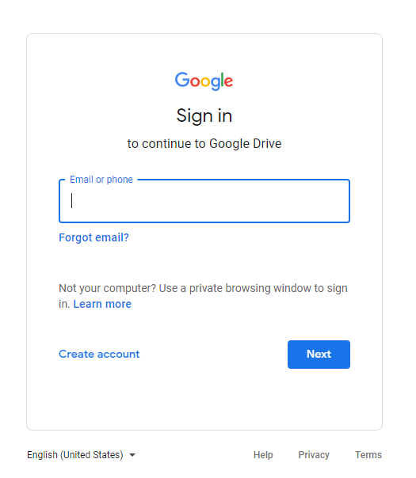
Getting Started
Colab uses Google Drive to store notebooks
Google account is required

Slide 6
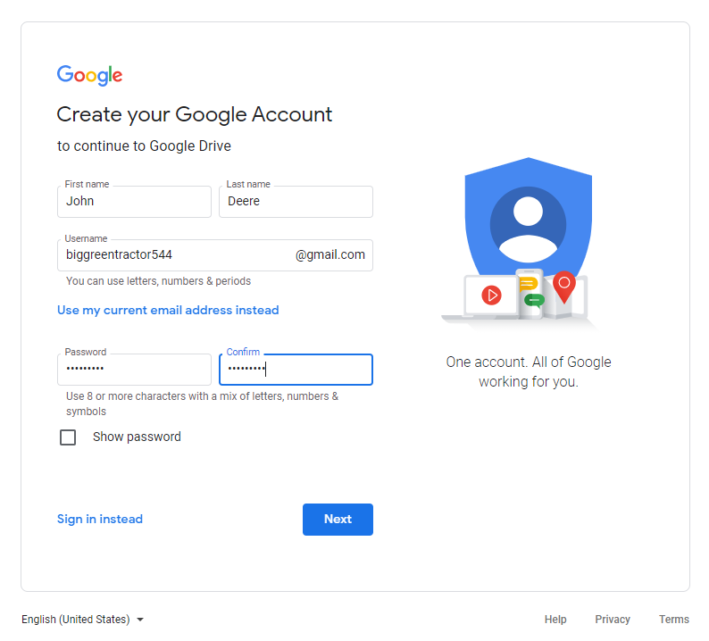
Getting Started

Slide 7
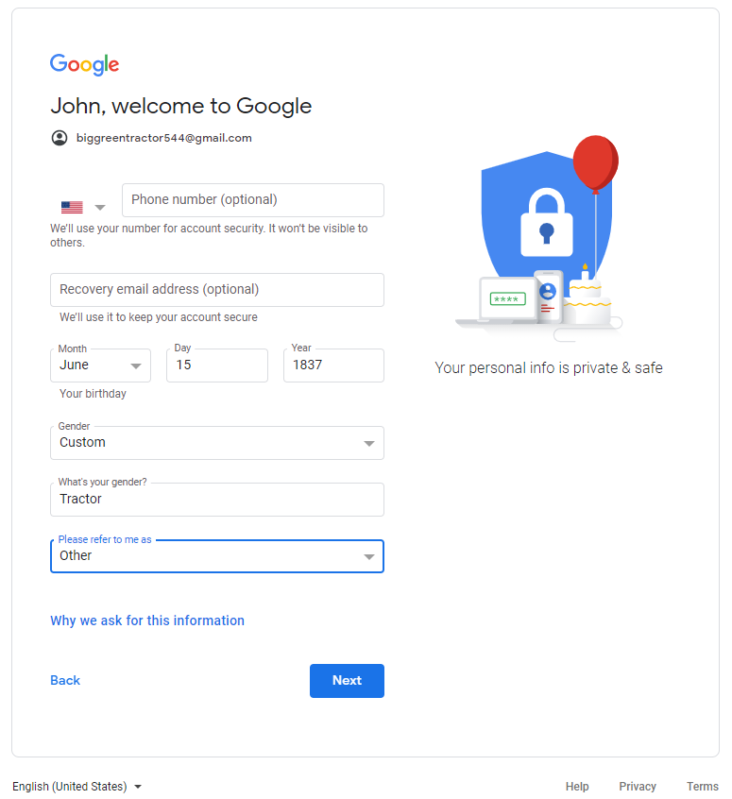
Getting Started
Once all your information is entered. Select next.
The next screen will be an information sharing agreement
Select I agree
You can delete this account later if you wish

Slide 8
Getting Started
Google Colab functionality

Slide 9
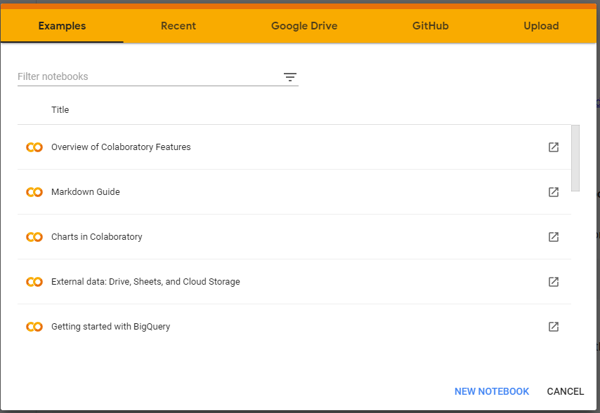
Getting Started
https://colab.research.google.com/notebooks/intro.ipynb?pli=1#recent=true
Select the new notebook to begin

Slide 10
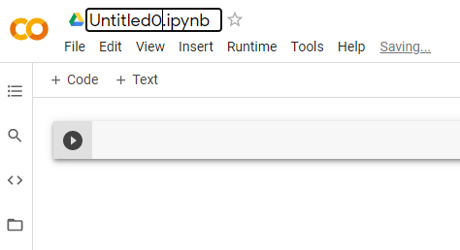
Getting Started
Click on the title block to update the name of the file
The red box is the code block

Slide 11
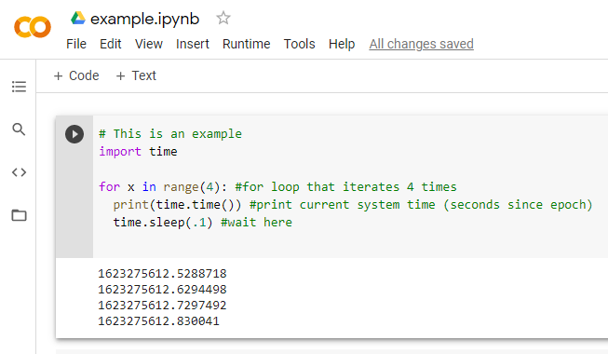
Getting Started
Click the code editor to begin writing python3 code.
When you are done click the play button to run your code

